Slide 1
Markov Chains

Slide 2
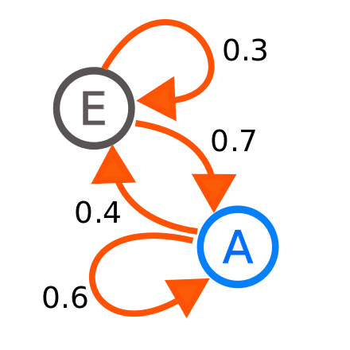
What are Markov Chains?
A Markov Chain is a mathematical system that experiences transitions from one state to another according to probabilistic rules.

Slide 3


Real life example #1 (Reddit)
There is a subreddit simulator where a bot generates meaningful comments, through use of GPT3 and Markov Chains. The simulator pulls in a significant chunk of all the comments and titles within each community that uses the word for word probabilities to build titles and comments from scratch.

Slide 4

Real life example #2 (Election Polls)
In 2016, markov chains were used to forecast the elections, which was characterized as a random process, and the knowledge of prior election outcomes to create probabilities and used to forecast elections in similar incremental approaches.

Slide 5
Going over states in Markov Chain

Slide 6
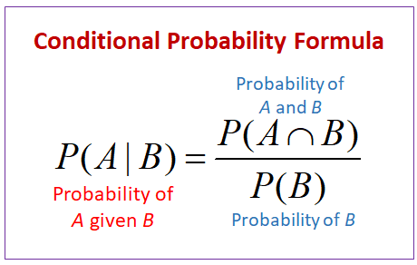
Conditional Probability

Slide 7
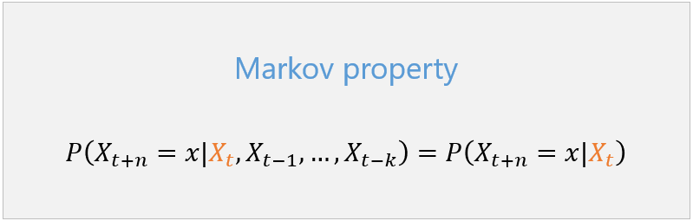
Mathematical Definition of Markov Chains
A stochastic process with the property that, given the value of X_{t}, the values of X_{s} for s>t are not influenced by the values of X_{u} for u<t.
As seen with this formula there is the Markov property

Slide 8

Markov Property
The future is independent of the past, conditioned on the present.

Slide 9

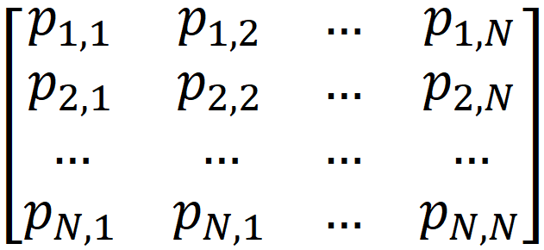
Probability transition matrix
The probability of X_{n+1} being in state j given that X_{n} is in state i is called the one-step transition probability.

Slide 10
Example of Markov Property

Slide 11
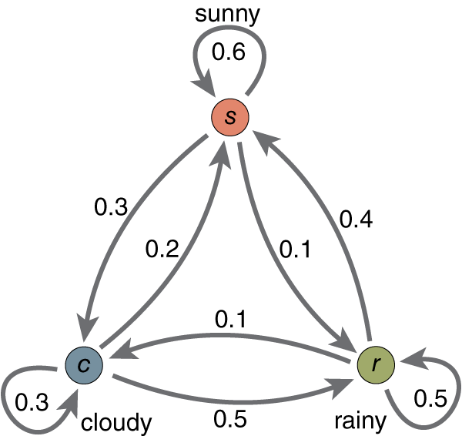
Practice problem
What’s the corresponding transition matrix?
Notes:
Ashwin

Slide 12
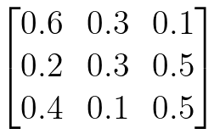
Practice problem
What’s the corresponding transition matrix?
Notes:
Ashwin

Slide 13
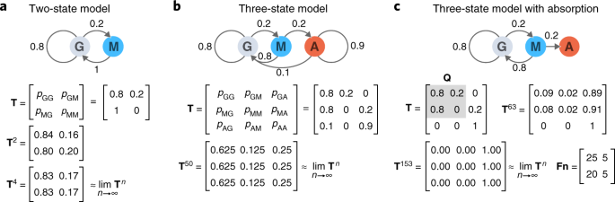
Practice problem 2
What’s the corresponding Markov Chain?
Notes:
Ashwin

Slide 14
Practice problem 2
What’s the corresponding Markov Chain?
Notes:
Ashwin

Slide 15
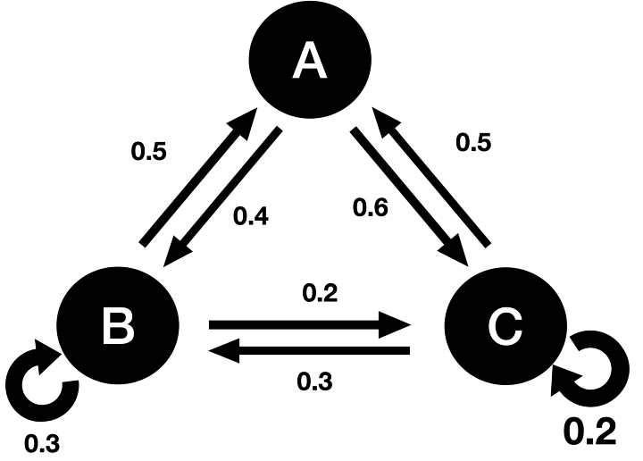
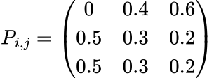
Multi-Step Transition Matrix
How can we represent jumping multiple steps at a time?
Notes:
Ashwin

Slide 16

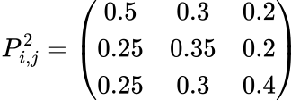
Multi-Step Transition Matrix
How can we represent jumping multiple steps at a time?
Notes:
Ashwin

Slide 17
What kinds of questions can you solve with MCs?
A lot of our functionals of markov chains are used using first step analysis.
The methods we break it down by considering the first transition, and invoking the law of total probability coupled with the Markov property to establish characteristic relationships among the unknown variables.

Slide 18
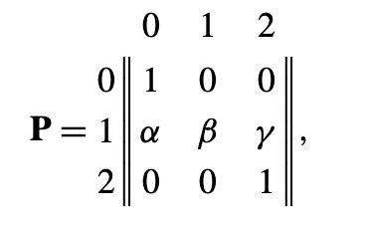
First example
First consider, the following transition matrix
Set T = min{n>=0; X_{n}=0 or X_{n}=2}
In this first example, we will be considering
u=Pr{X_{T}=0 | X_{0}=1}

Slide 19
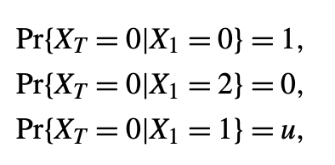
Answer

Slide 20
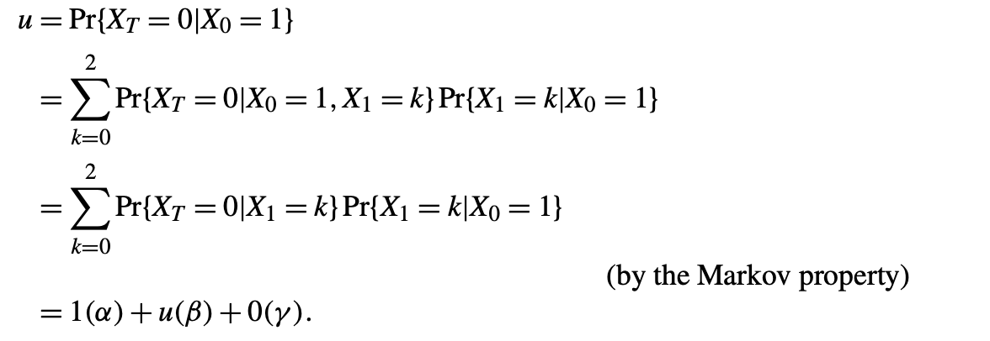
Answer cont.

Slide 21

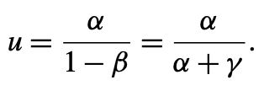
Answer cont.
We obtain the equation
Which gives,

Slide 22
Second example
We will use the same probability transition matrix as above, but we will find
v=E[T|X_{0}=1]

Slide 23
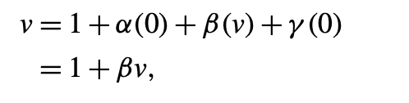
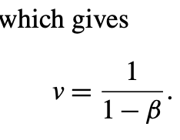
Answers cont.
Using first step analysis

Slide 24
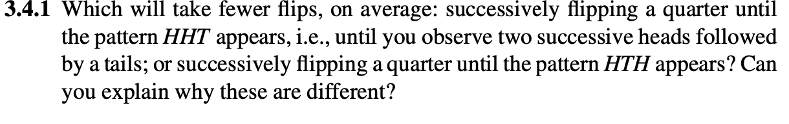

Slide 25
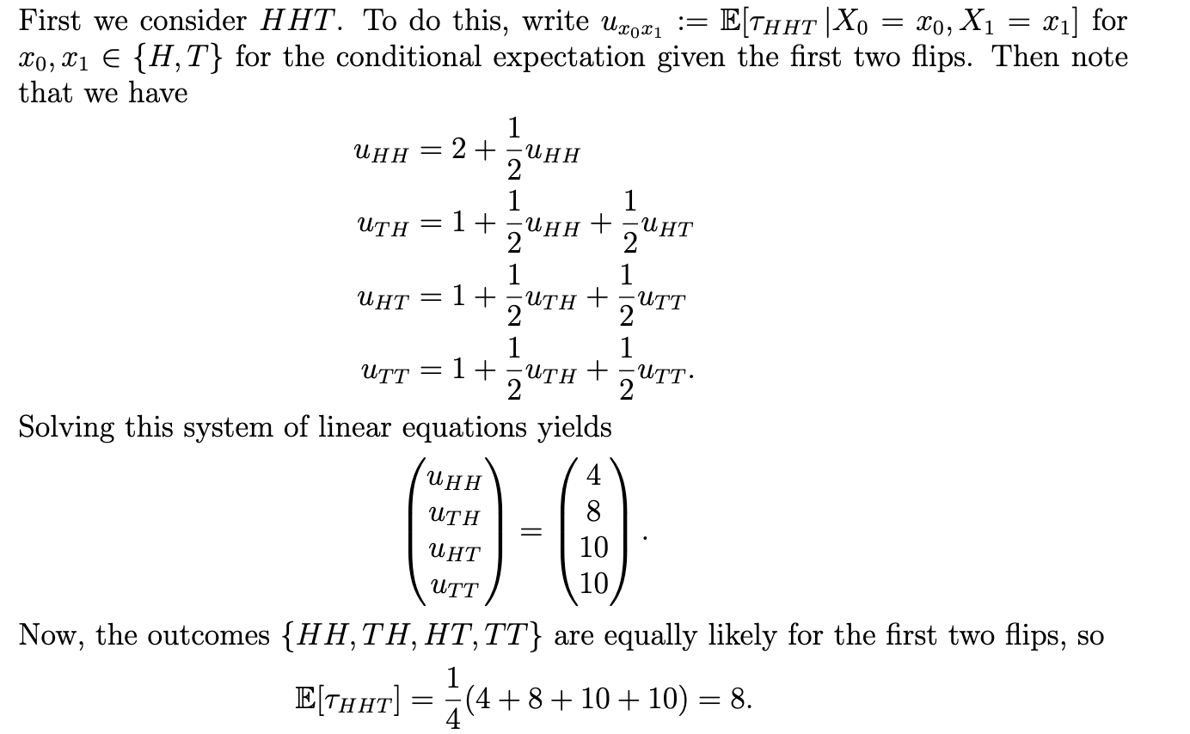

Slide 26
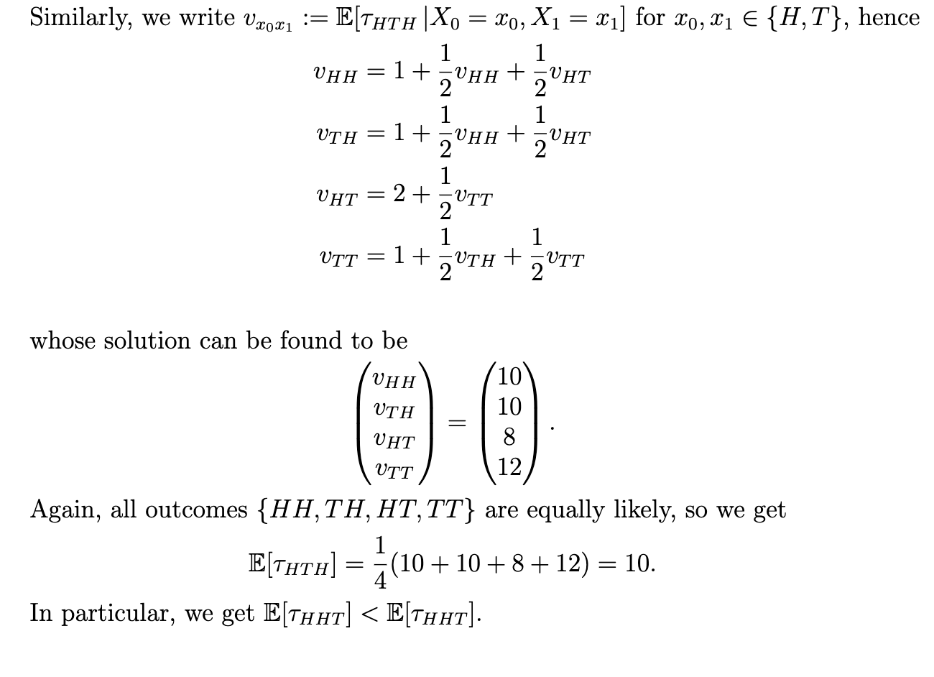

Slide 27
Thank you!!

Slide 28
You’re welcome

